Slide 1
Building data model and creating database
Introduction
in this project I have shown basic concept and steps that how data is build on the first place, I will perform different approaches and methods for creating table, building and cleaning using python, designing schema, how to insert clean data in sql server and data analysis.
For this project I have used jupyter notebook as my primary idle. for reading comma separated values i have used PANDAS and for accessing odbc databases i have used python module pyodbc, sql server also posgres for data analysis in sql .
This module pyodbc is used to connect with the sql server on Jupyter and perform data modeling.

Slide 2
Software AND HARDWARE
SOFTWARE –
PYTHON(JUPYTER NOTEBOOK), PANDAS
GOOGLE CHROME
SQL SERVER
POSTGRESQL
https://app.diagrams.net/ for designing schema and doing data modelling.
HARDWARE –
Intel(R) Core(TM) i7-9750H CPU @ 2.60GHz 2.59 GHz
RAM – 8.00 GB
GRAPHICS – 1060 NVIDIA (4GB)

Slide 3

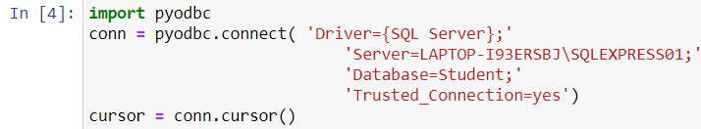
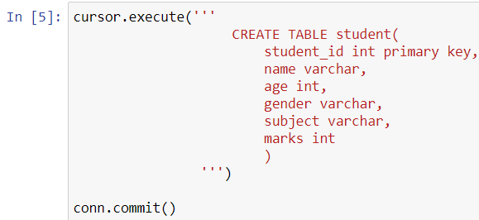
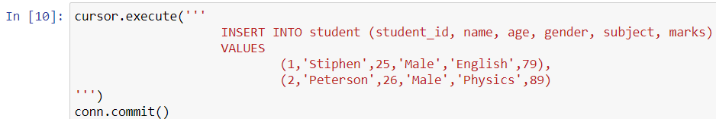
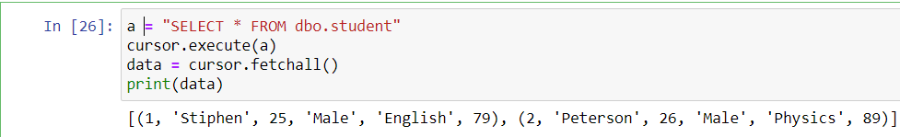
Creating Tables in sql server using python
FOR CONNECTION TO THE SQL SERVER WE HAVE TO FIRST INSTALL PYODBC
WE ARE CONNECTING TO THE SQL SERVER USING PYODBC.CONNECT()
WE ARE CREATING TABLE STUDENT FOR CHECKING THE CONNECTION AND FUNCTIONALITY, CONSTRAINSTS
AND EXECUTING THIS SQL QUERY USING CURSOR.EXECUTE()
AFTER THAT I HAVE INSERTED THE VALUES AND CHECKED IT
AT LAST I CHECKED THE VALUES IT IS DISPLAYING OR NOT

Slide 4

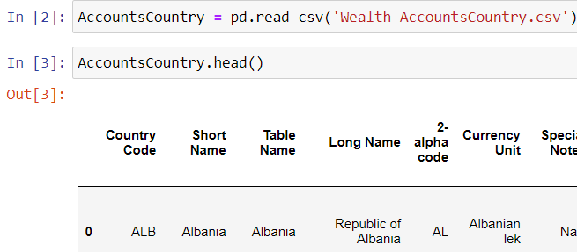
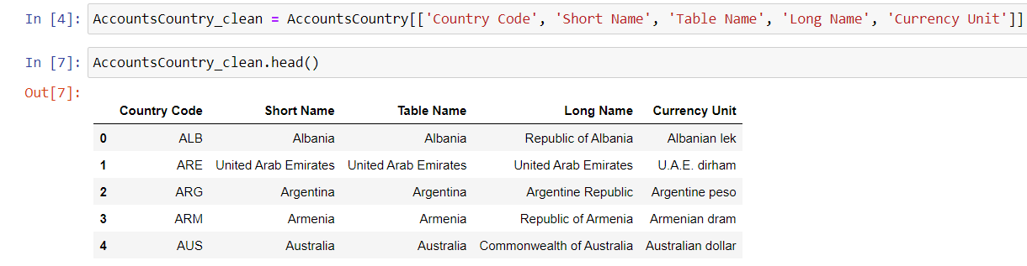
CLEANING and reading Tables using PANDAS
NOW WHEN WE CHECKED EVERYTHING AND READY FOR BUILDING AND CREATING TABLES AND MODELING FOR THAT I HAVE TAKEN THREE TABLES IMPORTED PANDAS CLEANED THE DATA, CREATED TABLE IN SQL SERVER, INSERTED VALUES WHICH WE HAVE CLEANED WITH PANDAS IN DATABASE POST.
FIRST OF ALL WE WILL IMPORT PYODBC FOR CONNECTION TO SQL SERVER AND PANDAS FOR CLEANING THE DATASET
NOW,WITH THE HELP OF PANDAS READ THE CSV FILE AND CHECKED THE HEADERS WHICH WE WANT IS INAPPROPRIATE OR CLEANING NEEDED
I HAVE TAKEN THE CLEAN VALUES IN NEW VARIABLE ACCOUNTSCOUNTRY_CLEAN IN PANDAS

Slide 5


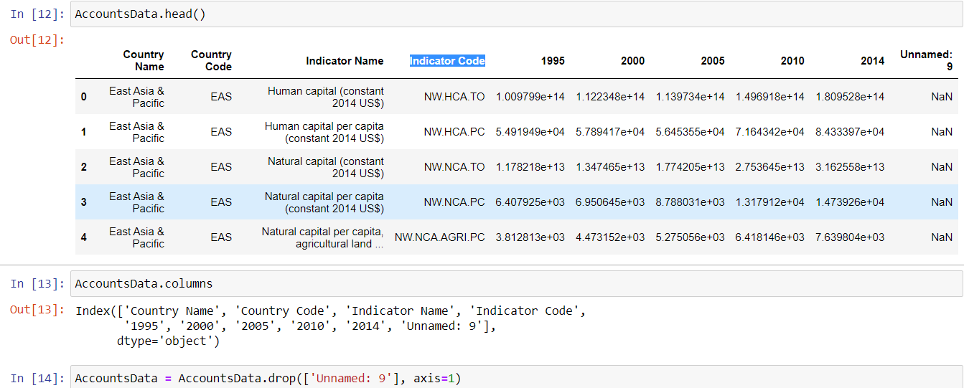
CLEANING and reading Tables using PANDAS CONTD….
NOW WE HAVE READ ALL THE TABLES
THERE WAS A PROBLEM IN ACCOUNTS DATA TABLE AS YOU CAN SEE COLUMN UNNAMED:9 , I DROPPED IT
AND IN ACCOUNTS SERIES EVERYTHING WAS FINE I HAVE TAKEN THREE COLUMNS FROM THERE(SERIES CODE, TOPIC, INDICATOR NAME).
AND AFTER THAT NOW MY TABLES ARE READY FOR DATA MODELING

Slide 6
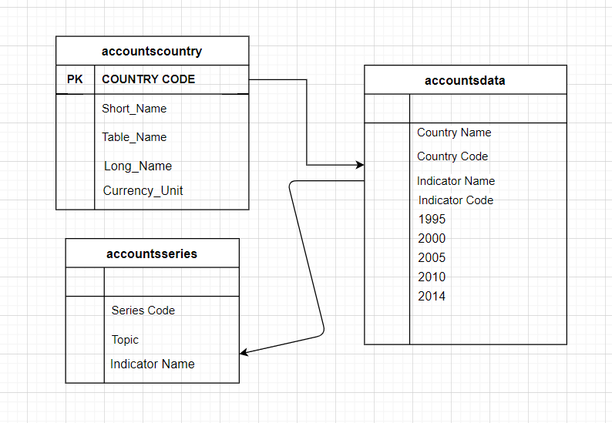
Created data model for sql server

Slide 7
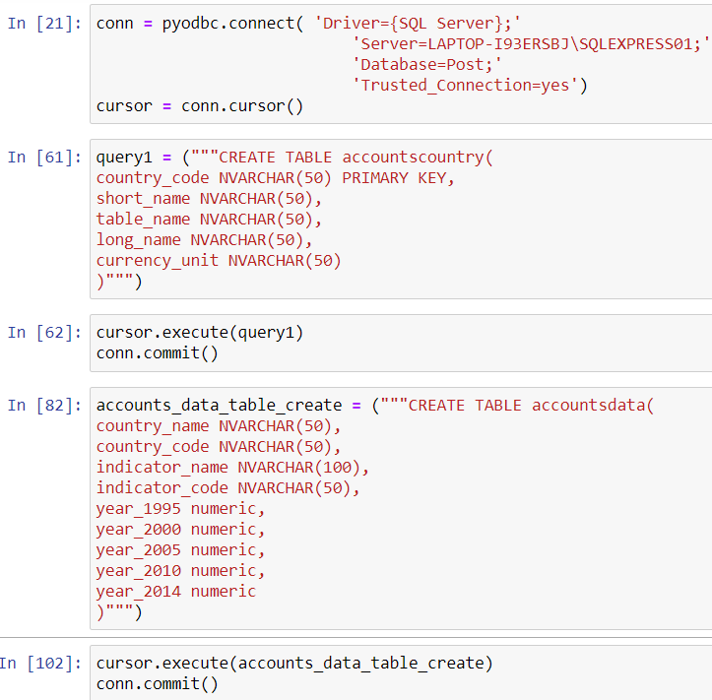
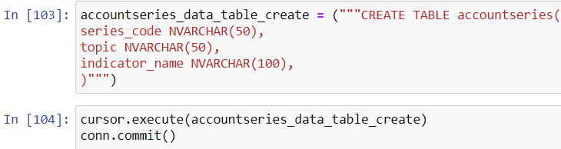
Once Data model is created, now we will insert clean values in sql server with the help of pyodbc using python as we have done earlier
AS YOU CAN SEE FIRST OF ALL WE BUILD THE CONNECTION, THEN CREATED SAME TABLE NAME AS MENTIONED IN THE TABLES WHICH I HAVE DOWNLOADED SO THAT IT COULD BE SAME AND UPDATED EASILY
THIS IS THIRD TABLE WITH SAME PROCESS

Slide 8
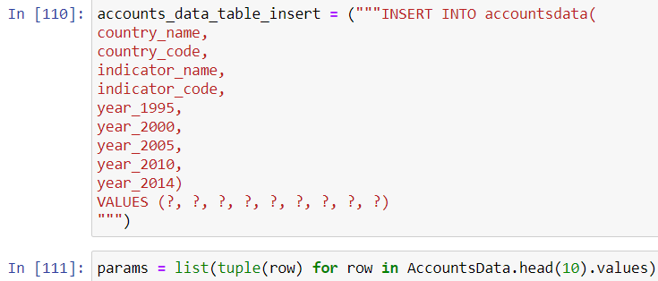
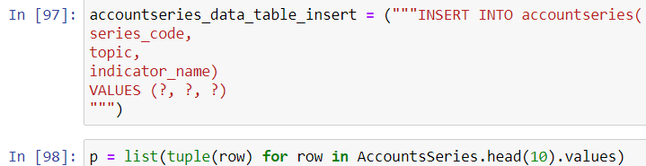
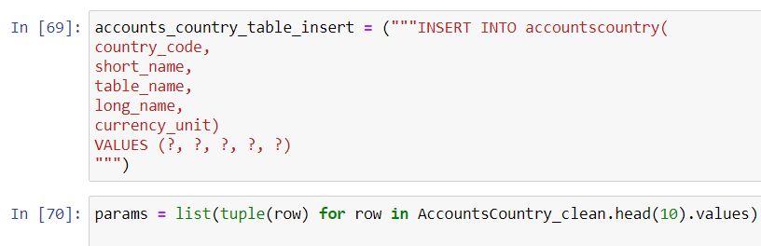
INSERTED CLEANED VALUES IN MY TABLES WHICH WILL BE PRESENT IN SQL SERVER
INSERTED ALL THE VALUES SUCCESSFULLY AND FOR THAT I HAVE MADE PARAMS FOR DATA TYPE AND FOR INSRTING VALUES ROW BY ROW

Slide 9
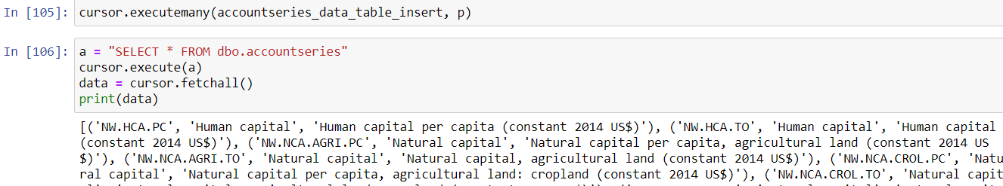
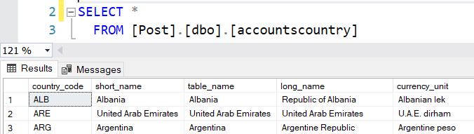
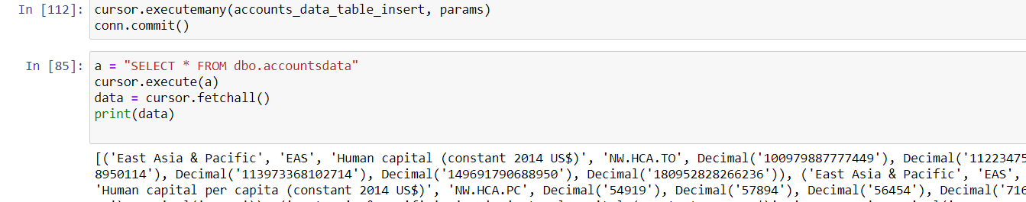
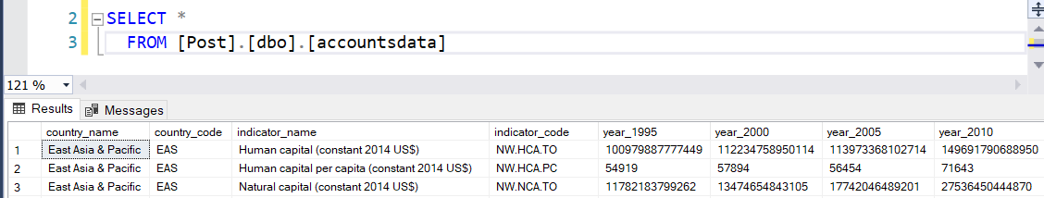
AT LAST I CHECKED THE VALUES INSERTED OR NOT IN PYTHON AND SQL SERVER
AS YOU CAN SEE VALUES ARE SHOWING
AS YOU CAN SEE VALUES ARE UPDATED IN SQL SERVER

Slide 10
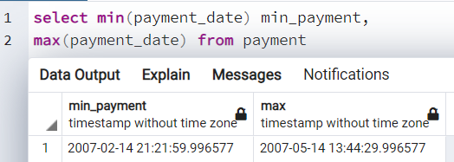
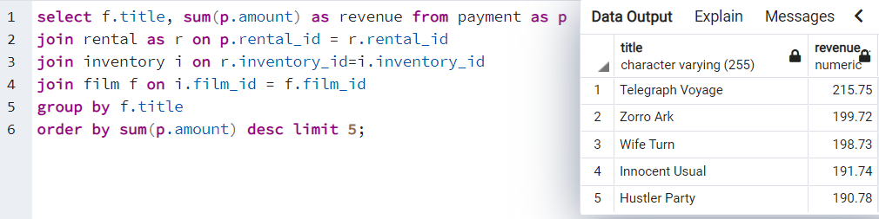
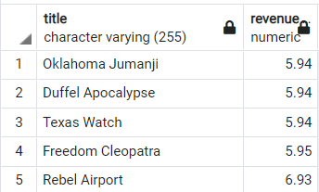
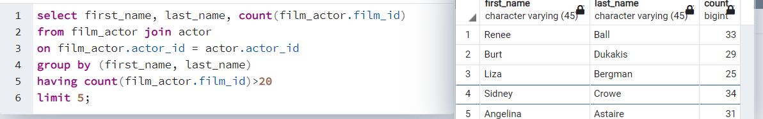
sql for data analysis(posgresql)
The dvdrental data is basically spread of three month from 2007-02-14 to 2007-05-14.
How much money does film makes by selling in terms of revenue(Highest earning film)
Display the names of the actors that acted in more than 20 movies.
How much money does film makes by selling in terms of revenue(lowest earning film)

Slide 11
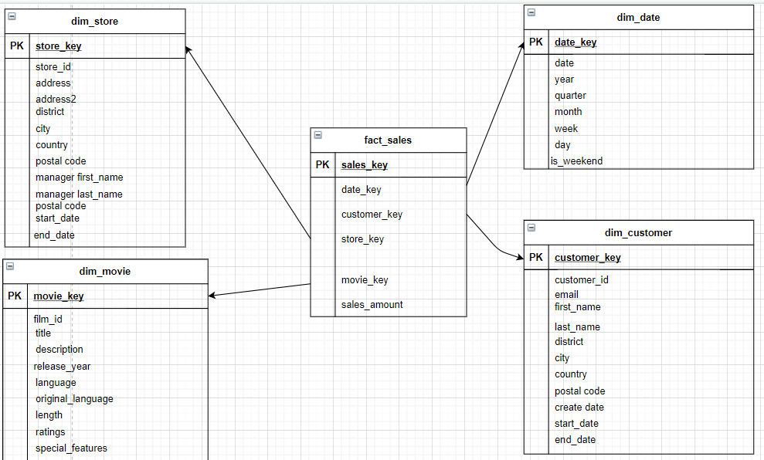
SCHEMA DESIGNING FOR DVDRENTAL SAMPLE DATA
I have designed simple star schema so that it can be easily untestable and shown primary key, fact table and dimension table

Slide 12
CONCLUSION
SO, I HAVE SHOWN BASIC FUNCTIONALITY OF CREATING AND BUILDING TABLES, DATA ANALYSIS AND DATA MODELLING, BASICALLY THESE THINGS WILL WORK ON BIG DATA FOR UNDERSTANDING CONCEPT AND METHODS I HAVE DONE THESE STEPS AND I LEARNED A LOT.
I HAVE TRIED NEW CONCEPTUAL LEARNING FROM MANY SOURCES AND GOT TO KNOW THAT IT IS A CRUCIAL AND BASIC STEPS FOR ANY DATA ENGINEER, DATA SCIENTIST, BIG DATA ANALYTICS ETC THOSE WHO are working on these profile, I have tried my best to explain every part in this ppt..
NOW AFTER THIS I AM PLANNING TO CREATE DATA WAREHOUSE FOR OLTP AND OLAP WITH THE HELP OF CLOUD PLATFORM LIKE AZURE, AWS, IBM.

Slide 13


